Slide 1
Chapter 3: Function calls and the Stack pointer
Topics
IA64 stack discipline
%rsp
Push, pop
Call, ret

Slide 2
Announcements
Bomb Lab #2 due Friday Oct 4 by 11:55 pm
TAs introduce in recitation this week
Can work in teams of 2
Secret bomb phase for extra credit
Graded on solutions file that you turn in, not the scoreboard (for guidance only)
Will be releasing another quiz on stack assembly
Read Chapter 3.1-3.12 (except 3.11) & do practice probs

Slide 3
Procedures/Function Calls
Memory
Procedures/functions allow logical grouping of code
Enable reuse of code, which can be called from different places in the program
factorial(10);
polynomial(…);
Data
factorial(7);
factorial(int n) {
…
…
}
Computes
factorial
Code
polynomial(…) {
…
…
}
Computes
polynomial

Slide 4
Motivation for a Call Stack (1)
Memory
Imagine the world of early programming
No functions
No stack pointers or stacks. No frame pointers or frames
Data
Computes
factorial
Code
Computes
polynomial

Slide 5
Motivation for a Call Stack (2)
Suppose 2 parts of code want to execute the same computation
Repeating the computational code is inefficient
Maintaining multiple copies of same computation is inconvenient
Computes
factorial
Computes
factorial
Computes
polynomial

Slide 6
Motivation for a Call Stack (3)
Instead, write the common code once and jump to it from different locations
Problem #1: How do you jump back?
0x20
jmp 0x68
Jump back where?
0x44
jmp 0x68
Must remember the address where you were calling the common code from
Could allocate some memory to store the return address for this factorial code
0x68
Computes
factorial
Computes
polynomial

Slide 7
Motivation for a Call Stack (4)
Before each jump to the common code, store return address in special memory location
movq $0x28, (0xf0)
0x20
jmp 0x68
Store the return
address of the next
instruction after
the jump in a special
memory location, e.g.
0xf0 in this example
for factorial code
(location not shown)
movq $0x4c, (0xf0)
0x44
jmp 0x68
Jump back using this special location
0x68
Problem: can’t share 1 mem location for all return addresses
1 set of common code may call another set
Instead, would need 1 return address location for each set of common code
Computes
factorial
jmp *(0xf0)
Computes
polynomial
Problem:
Waste space
& Recursion?
Notes:
Example: polynomial code may want to call factorial code.
Note: each common code fragment would need to be separately programmed to consult a different memory location to find its return address.
A key problem of having one memory location to store the return address for each function is this won’t work for recursive calls. In that case, you need to have a memory location to store the return address for each *invocation* of a function.
Another problem is that you can’t have two calls concurrently inside the same function, as would occur in a multi-threaded program.
A third problem is that if the function is never called, then you’ve wasted space allocating memory for storing a return address.

Slide 8
Motivation for a Call Stack (5)
Problem #2: How to pass parameters to common code?
Example: from the 1st jump point, may want to calculate 10!, while 2nd jump point may want to calculate 7!
Again, could allocate special memory to store parameters before jumping
movq $10, (0xf8)
0x20
jmp 0x68
Store parameters
before jump
movq $7, (0xf8)
0x44
jmp 0x68
Retrieve parameters
after jump
movq (0xf8), %rbx
0x68
Computes
factorial
Problem:
Waste
Memory
Computes
polynomial
The called common code is programmed to look in this special memory location to retrieve parameters
Problem:
Recur-
sion?
Notes:
A problem again is inefficiency - if the function is never called, then the space allocated for saving parameters is wasted memory.
The problem again is also recursion.

Slide 9
Motivation for a Call Stack (6)
Problem #3: Wasting memory
the common code may never be called, wasting allocated memory for parameters and return addresses
Problem #4: Wasting memory II
the common code may allocate local variables only used within the common code, yet the common code may never be called, wasting memory

Slide 10
Motivation for a Call Stack (7)
Design goals: want a solution to support functions that:
Automatically stores the return address before a function is called, and retrieves that return address when exiting a function
Allows storage of parameters before a function is called, and parameter retrieval within the function
Is memory-efficient for return addresses, parameters, and local variables
Each instance of a function should have its own unique set of {return address, parameters, and local variables}, to support recursion (and multi-threading)

Slide 11
Solution: a Call Stack
Memory
initial %rsp
0xMAX
Supports function calls by storing the return address, parameters, and local variables on a stack
Allocate a special reusable region of memory for the stack
Create a special CPU register %rsp that the stores the location of the top of the stack, i.e. the stack pointer
Create a CPU instruction call that before jumping to a function stores (pushes) the return address on the stack
Create a CPU instruction ret that jumps to the return address upon exiting from the function, popping the address from the stack
Stack
Space
Data
Code
0x0000

Slide 12
Solution: a Call Stack (2)
Memory
initial %rsp
0xMAX
params
On each function call, and before executing the body of the function,
Push parameters onto the stack
Push return address onto the stack
Push/allocate local variables on the stack
return addr
local
variables
new
%rsp
Stack grows up/down
Stack
Space
Must also save the old location of the stack pointer so it can be restored to its old value after exiting the function
If a function f1 calls a function f2, then the stack grows down even more. If f2 calls a function f3, that grows the stack.
As each function finishes/calls return, its local variables, return address, and parameters are popped off the stack (deallocated), shrinking the stack
Data
Code
0x0000
Notes:
As we’ll see later, usually there is also room made on the call stack for saved registers that are restored when the procedure exits.

Slide 13
Solution: a Call Stack (3)
Memory
0xMAX
params
In this way, we satisfy the original design goals:
Enables passing parameters to functions
Automated support for storing the return address
Memory-efficient storage that reuses memory and only allocates space for parameters, return addresses, and local variables if a function is called
Supports recursion – each instance/call of a function has its own stack frames to store its own return address, parameters, and local variables
return addr
local
variables
new
%rsp
Stack grows up/down
Stack
Space
Data
Code
0x0000

Slide 14
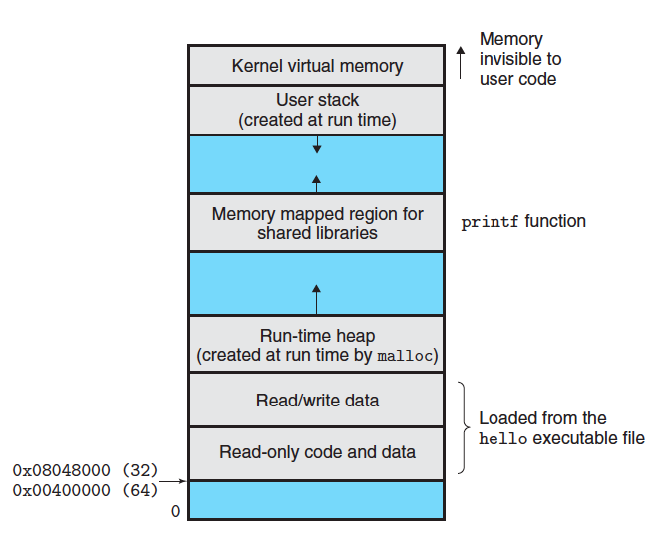
Layout of a Program in Memory
Code, data, heap and stack segments
Data stores global variables
Stack grows down from high memory by convention on x86-64
Stores local variables
Supports function calls
Heap grows up from low memory by convention
Supports dynamic run-time memory allocation like malloc()
MAX
Notes:
This is actually virtual memory, not physical memory.

Slide 15
Pushing parameters onto the stack
In X86-64:
The first 6 arguments are passed into a procedure using 6 CPU registers:
Argument # | 1 | 2 | 3 | 4 | 5 | 6
register | %rdi | %rsi | %rdx | %rcx | %r8 | %r9
The remaining 7+ arguments if any are passed by pushing onto the call stack
If an argument is less than 8 bytes wide, then the appropriate lower order bytes of the above registers are used
In 32-bit X86 systems:
All parameters are passed into a procedure by pushing them onto the stack
This is slower than passing by register, because memory accesses to the stack are slower than CPU registers
Notes:
See Figure 3.28 p. 245.

Slide 16
x86-64 Stack
Region of memory managed with stack discipline
Grows toward lower addresses
Register %rsp contains lowest stack address
address of “top” element
Stack “Bottom”
Increasing
Addresses
Stack Grows
Down
Stack Pointer: %rsp
Stack “Top”

Slide 17
x86-64 Stack: Push
Stack “Bottom”
pushq Src
Fetch operand at Src
Decrement %rsp by 8
Write operand at address given by %rsp
Increasing
Addresses
Stack Grows
Down
Stack Pointer: %rsp
-8
Stack “Top”

Slide 18
x86-64 Stack: Pop
Stack “Bottom”
popq Dest
Read value at address given by %rsp
Increment %rsp by 8
Store value at Dest (must be register)
Increasing
Addresses
Stack Grows
Down
Stack Pointer: %rsp
+8
Stack “Top”

Slide 19
Procedure Control Flow
Use stack to support procedure call and return
Procedure call: call label
Push return address on stack
Jump to label
Return address:
Address of the next instruction right after call
Example from disassembly
Procedure return: ret
Pop address from stack
Jump to address

Slide 20
x86-64/Linux Stack Frame
Current Stack Frame (“Top” to Bottom)
“Argument build:” Parameters for function about to call
Local variables If can’t keep in registers
Saved register context
Old frame pointer (optional)
Caller Stack Frame
Return address
Pushed by call instruction
Arguments for this call
Caller
Frame
Arguments
7+
Frame pointer %rbp
Return Addr
Old %rbp
(Optional)
Saved
Registers
+
Local
Variables
Argument
Build
(Optional)
Stack pointer
%rsp

Slide 21
Code Examples
void multstore
(long x, long y, long *dest) {
long t = mult2(x, y);
*dest = t;
}
0000000000400540 <multstore>:
400540: push %rbx # Save %rbx
400541: mov %rdx,%rbx # Save dest
400544: callq 400550 <mult2> # mult2(x,y)
400549: mov %rax,(%rbx) # Save at dest
40054c: pop %rbx # Restore %rbx
40054d: retq # Return
long mult2
(long a, long b)
{
long s = a * b;
return s;
}
0000000000400550 <mult2>:
400550: mov %rdi,%rax # a
400553: imul %rsi,%rax # a * b
400557: retq # Return

Slide 22
Control Flow Example #1
•
•
•
0x130
0000000000400540 <multstore>:
•
•
400544: callq 400550 <mult2>
400549: mov %rax,(%rbx)
•
•
0x128
0x120
%rsp
0x120
%rip
0x400544
0000000000400550 <mult2>:
400550: mov %rdi,%rax
•
•
400557: retq

Slide 23
Control Flow Example #2
•
•
•
0x130
0000000000400540 <multstore>:
•
•
400544: callq 400550 <mult2>
400549: mov %rax,(%rbx)
•
•
0x128
0x120
0x118
0x400549
%rsp
0x118
%rip
0x400550
0000000000400550 <mult2>:
400550: mov %rdi,%rax
•
•
400557: retq

Slide 24
Control Flow Example #3
•
•
•
0x130
0000000000400540 <multstore>:
•
•
400544: callq 400550 <mult2>
400549: mov %rax,(%rbx)
•
•
0x128
0x120
0x118
0x400549
%rsp
0x118
%rip
0x400557
0000000000400550 <mult2>:
400550: mov %rdi,%rax
•
•
400557: retq

Slide 25
Control Flow Example #4
•
•
•
0x130
0000000000400540 <multstore>:
•
•
400544: callq 400550 <mult2>
400549: mov %rax,(%rbx)
•
•
0x128
0x120
%rsp
0x120
%rip
0x400549
0000000000400550 <mult2>:
400550: mov %rdi,%rax
•
•
400557: retq

Slide 26
Procedure Data Flow
Registers
Stack
First 6 arguments
Return value
• • •
%rdi
%rsi
Arg n
%rdx
• • •
%rcx
%r8
Arg 8
%r9
Arg 7
%rax
Only allocate stack space when needed

Slide 27
Data Flow Examples
void multstore
(long x, long y, long *dest) {
long t = mult2(x, y);
*dest = t;
}
0000000000400540 <multstore>:
# x in %rdi, y in %rsi, dest in %rdx
• • •
400541: mov %rdx,%rbx # Save dest
400544: callq 400550 <mult2> # mult2(x,y)
# t in %rax
400549: mov %rax,(%rbx) # Save at dest
• • •
long mult2
(long a, long b)
{
long s = a * b;
return s;
}
0000000000400550 <mult2>:
# a in %rdi, b in %rsi
400550: mov %rdi,%rax # a
400553: imul %rsi,%rax # a * b
# s in %rax
400557: retq # Return

Slide 28
Supplementary Slides

Slide 29
Stack Operation Examples
pushl %eax
popl %edx
0x110
stack
0x110
0x110
0x10c
0x10c
0x10c
0x108
123
0x108
123
0x108
123
0x104
213
0x104
213
CPU registers
%eax
213
%eax
213
%eax
213
%edx
555
%edx
555
%edx
555
213
%esp
0x108
%esp
0x108
0x104
%esp
0x104
0x108

Slide 30
Procedure Control Flow
Use stack to support procedure call and return
Procedure call:
call label Push return address on stack; Jump to label
Example: if my function name is swap_numbers, then
call swap_numbers
Return address value
Address of instruction beyond call
Example from disassembly
804854e: e8 3d 06 00 00 call 8048b90 <main>
8048553: 50 pushl %eax
Return address = 0x8048553
Procedure return:
ret Pop address from stack; Jump to address

Slide 31
Procedure Call Example
804854e: e8 3d 06 00 00 call 8048b90 <main>
8048553: 50 pushl %eax
call 8048b90
0x110
stack
0x110
0x10c
0x10c
0x108
123
0x108
123
0x104
0x8048553
CPU registers
%esp
0x108
%esp
0x108
0x104
%eip
0x804854e
%eip
0x804854e
0x8048b90
%eip is program counter

Slide 32
Procedure Return Example
8048591: c3 ret
ret
0x110
0x110
0x10c
0x10c
0x108
123
0x108
123
0x104
0x8048553
0x8048553
%esp
0x104
%esp
0x104
0x108
%eip
0x8048591
%eip
0x8048591
0x8048553
%eip is program counter

Slide 33
IA32/Linux Stack Frame
Caller Stack Frame
Push parameters for function about to call
“Argument build”
Last argument pushed first, … first argument is pushed last – see p.220 of textbook
Push return address
Pushed by call instruction
Current Callee Stack Frame
Push (save) old frame pointer
Saved register context
Allocate space for local variables
More argument building as needed
Caller
Frame
Arguments
Frame Pointer
(%ebp)
Return Addr
Old %ebp
Saved
Registers
+
Local
Variables
Current
Callee
Frame
Argument
Build
Stack Pointer
(%esp)
Notes:
The last argument is pushed first, and the first argument is pushed last - see p. 220 of the textbook.

Slide 34
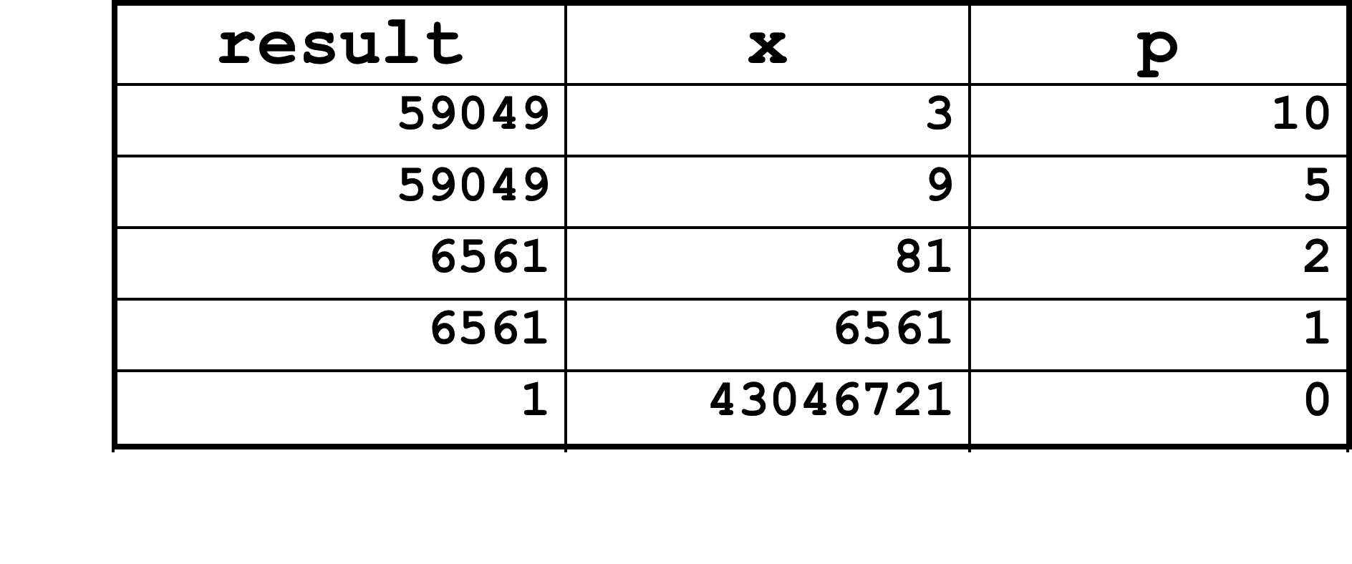
ipwr Computation
/* Compute x raised to nonnegative power p */
int ipwr_for_fast(int x, unsigned p) {
int result;
for (result = 1; p != 0; p = p>>1) {
if (p & 0x1)
result *= x;
x = x*x;
}
return result;
}

Slide 35
Summarizing
C Control
if-then-else
do-while
while
switch
Assembler Control
jump
Conditional jump
Compiler
Must generate assembly code to implement more complex control
Standard Techniques
All loops converted to do-while form
Large switch statements use jump tables
Conditions in CISC
CISC machines generally have condition code registers
Conditions in RISC
Use general registers to store condition information
Special comparison instructions
E.g., on Alpha:
cmple $16,1,$1
Sets register $1 to 1 when Register $16 <= 1

